Slide 1
Task Round
Kalpataru Dhakate

Slide 2
Objective of the Project
To predict the wine quality using different Machine Learning Algorithm

Slide 3
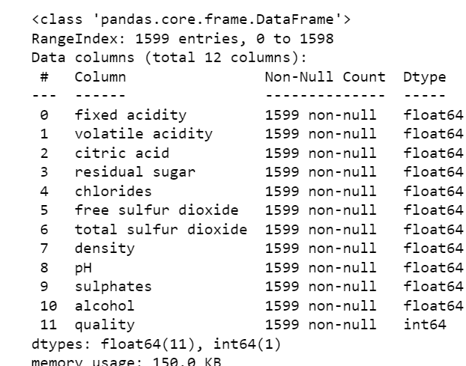
Wine Quality Dataset Description
We can say that wine quality dataset has –
Rows : 1599
Column : 12
Column names are :
Fixed acidity
Volatility acidity
Citric acid
Residual sugar
Chlorides
Free sulfur dioxide
Total sulphur dioxide
Density
pH
Sulphates
Alcohol
Quality
We can also see that out of 12 columns , Dtype of 11 columns are ‘float64’ Whereas that of 1 column i.e quality dtype is ‘int64’
Dtype is type of data each variable has.

Slide 4
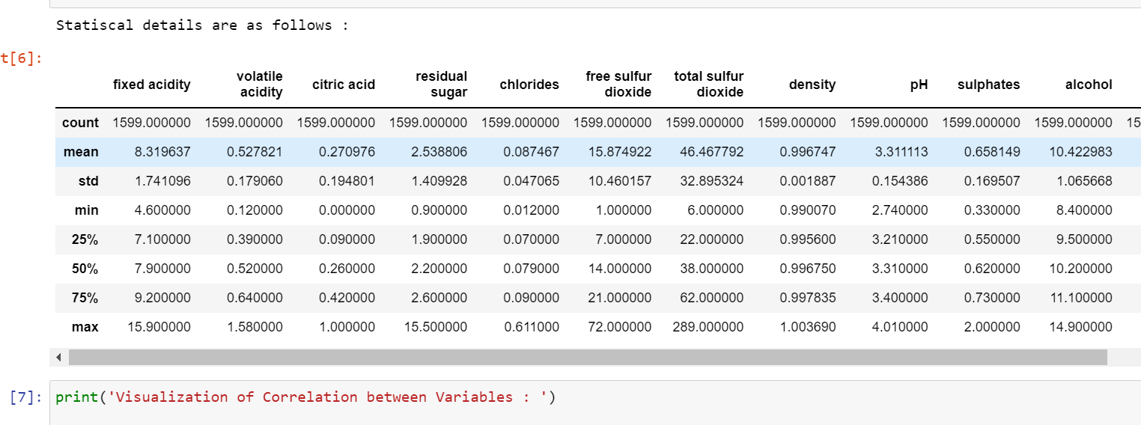
Cont ……
1. Checking for null values :
By referring above image we can say that there is no null values present in the data.
2. Statistical detail of each columns :
It gives idea count, mean, standard deviation, min, percentile[25%,50%,75%], max of each columns.

Slide 5
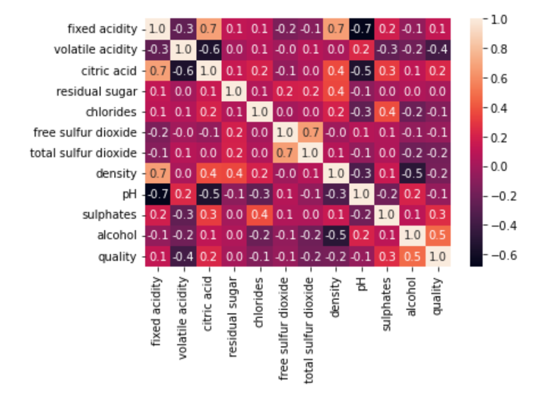
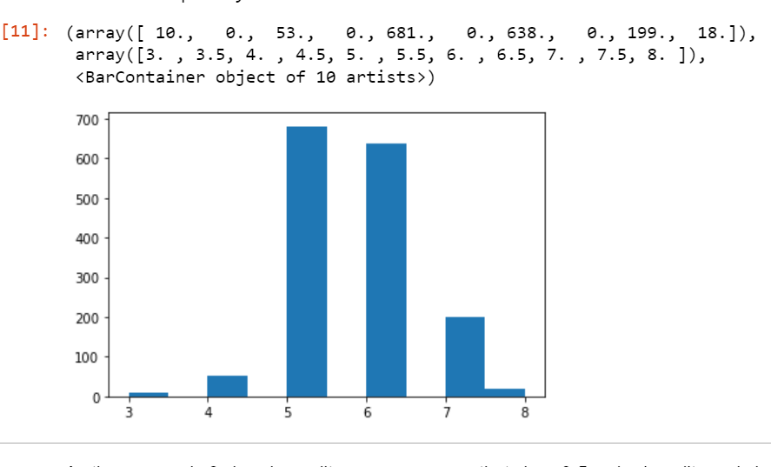
3. To find out the correlation of each columns :
As far our concern we can see that quality is positively correlated with alcohol, citric acid, sulphates and negatively correlated with volatile acidity.
4. Updating the classes of quality :
As there are only 6 class in quality we can assume that class 0-5 as bad quality and class 6-8 as good quality.

Slide 6
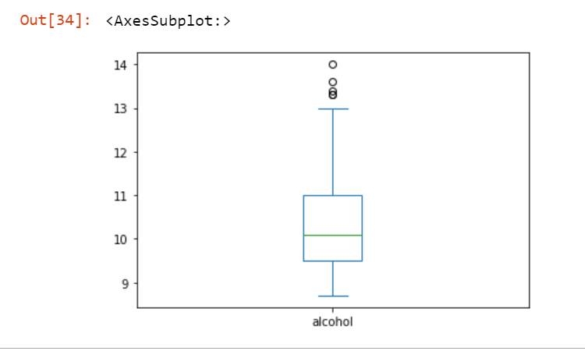
5. Checking for Outliers and Dropping it of :
We check for the outlier using boxplot and if they are present it is removed. For e.g. We can see outliers present in alcohol so we remove it.
6. After Data preprocessing, independent and depended variables are extracted, and fitted to three different model i.e. Logistic Regression, Decision Tree, Boosting Classifier.
7. Accuracy of Each Model was found to be :
1. Logistic Regression : 79%
2. Decision Tree : 76%
3. Boosting Classifier : 78%

Slide 7
Conclusion
We predicted the quality of wine with the help of three model Logistic Classifier, Decision Tree, Boosting Classifier and based on the accuracy that Logistic Classifier has higher accuracy as compared to Decision Tree and Boosting Classifier and hence we can concluded that Logistic Classifier can be a better model to predict the quality of wine.

